Slide 1
MLOps life-cycle, process and capabilities
Pravin Y Pawar
Google's Practitioners guide to MLOps:
A framework for continuous delivery and automation of machine learning.

Slide 2
Google Cloud’s AI Adoption Framework
Google Cloud’s AI Adoption Framework provides guidance for technology leaders
who want to build an effective artificial intelligence (AI) capability in order to transform their business
covers AI challenges around people, data, technology, and process,
structured in six different themes: learn, lead, access, secure, scale, and automate
Scale concerns the extent to which use cloud managed ML services that scale with large amounts of data
and large numbers of data processing and ML jobs, with reduced operational overhead
Automate concerns the extent to which able to deploy, execute, and operate technology for data
processing and ML pipelines in production efficiently, frequently, and reliably
Organizations can use the framework to identify gaps in building an integrated ML platform
focus on the scale and automate themes from Google’s AI Adoption Framework
The decision about whether (or to which degree) to adopt each of these processes and capabilities in your organization depends on your business context
For example, you must determine the business value that the framework creates when compared to the cost of purchasing or building capabilities (for example, the cost in engineering hours)

Slide 3
Models don’t make it into production
If they do, they break because they fail to adapt to changes in the environment.
Only one in two organizations has moved beyond pilots and proofs of concept
Moreover, 72% of a cohort of organizations that began AI pilots before 2019 have not been able to deploy even a single application in production
Algorithmia’s survey of the state of enterprise machine learning found that 55% of companies surveyed have not deployed an ML model
This is due to a variety of issues
Teams engage in a high degree of manual and one-off work
do not have reusable or reproducible components,
processes involve difficulties in handoffs between data scientists and IT
Deloitte identified lack of talent and integration issues as factors that can stall or derail AI initiatives
Algorithmia’s survey highlighted that challenges in deployment, scaling, and versioning efforts still hinder teams from getting value from their investments in ML
Capgemini Research noted that the top three challenges faced by organizations in achieving deployments at scale are lack of mid- to senior-level talent, lack of change-management processes, and lack of strong governance models for achieving scale.

Slide 4
Complexities of ML application
Complexities include the following:
Preparing and maintaining high-quality data for training ML models
Tracking models in production to detect performance degradation
Performing ongoing experimentation of new data sources, ML algorithms, and hyperparameters, and then tracking these experiments
Maintaining the veracity of models by continuously retraining them on fresh data
Avoiding training-serving skews that are due to inconsistencies in data and in runtime dependencies between training environments and serving environments
Handling concerns about model fairness and adversarial attacks

Slide 5
ML engineering
The common theme is that ML systems cannot be built in an ad hoc manner,
isolated from other IT initiatives like DataOps and DevOps
Also cannot be built without adopting and applying sound software engineering practices,
while taking into account the factors that make operationalizing ML different from operationalizing other types of
software
Organizations need an automated and streamlined ML process
help the organization successfully deploy ML models in production
helps manage risk when organizations scale the number of ML applications to more use cases in changing environments
helps ensure that the applications are still in line with business goals
This is where ML engineering can be essential!
ML engineering is at the center of building ML-enabled systems, which concerns the development and
operationalizing of production-grade ML systems
provides a superset of the discipline of software engineering that handles the unique complexities of the practical
applications of ML

Slide 6
MLOps
MLOps is a methodology for ML engineering that
unifies ML system development (the ML element) with ML system operations (the Ops element)
advocates formalizing and (when beneficial) automating critical steps of ML system construction
MLOps provides a set of standardized processes and technology capabilities
for building, deploying, and operationalizing ML systems rapidly and reliably
MLOps supports ML development and deployment in the way that DevOps and DataOps support application engineering and
data engineering (analytics)!
When deploy an ML model, also need to worry about changes in the data, changes in the model, users trying to game the system, and so on
MLOps practices can result in the following benefits over systems that do not follow MLOps practices:
Shorter development cycles, and as a result, shorter time to market
Better collaboration between teams
Increased reliability, performance, scalability, and security of ML systems
Streamlined operational and governance processes
Increased return on investment of ML projects

Slide 7
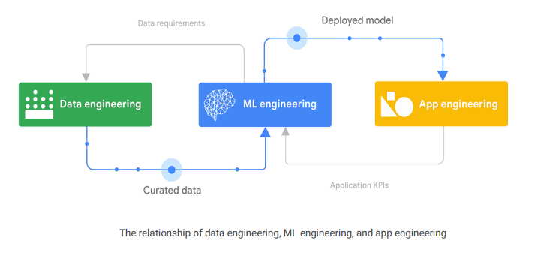
Building an ML-enabled system
Multifaceted undertaking that combines data engineering, ML engineering, and application engineering tasks

Slide 8
Building an ML-enabled system(2)
Multifaceted undertaking that combines data engineering, ML engineering, and application engineering tasks
Data engineering involves ingesting, integrating, curating, and refining data
to facilitate a broad spectrum of operational tasks, data analytics tasks, and ML tasks
If an organization does not have robust data engineering processes and technologies,
it might not be set up for success with downstream business intelligence, advanced analytics, or ML projects
ML models are built and deployed in production using curated data that is usually created by the data engineering team
The models do not operate in silos, they are components of, and support, a large range of application systems,
such as business intelligence systems, line of business applications, process control systems, and embedded systems
Integrating an ML model into an application is a critical task involves
making sure first that the deployed model is used effectively by the applications,
monitoring model performance
should also collect and monitor relevant business KPIs which helps in understanding the impact of the ML model on the business and adapt accordingly

Slide 9
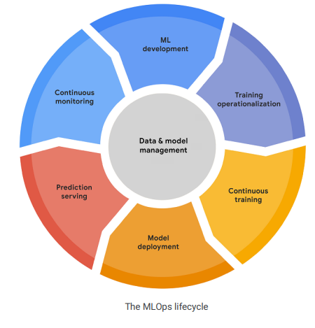
The MLOps lifecycle
Encompasses seven integrated and iterative processes

Slide 10
The MLOps lifecycle(2)
The processes can consist of
ML development
concerns experimenting and developing a robust and reproducible model training procedure (training pipeline code),
which consists of multiple tasks from data preparation and transformation to model training and evaluation
Training operationalization
concerns automating the process of packaging, testing, and deploying repeatable and reliable training pipelines
Continuous training
concerns repeatedly executing the training pipeline in response to new data or to code changes, or on a schedule
potentially with new training settings
Model deployment
concerns packaging, testing, and deploying a model to a serving environment for online experimentation and production serving
Prediction serving
is about serving the model that is deployed in production for inference
Continuous monitoring
is about monitoring the effectiveness and efficiency of a deployed model
Data and model management
central, cross-cutting function for governing ML artifacts to support auditability, traceability, and compliance
also promote shareability, reusability, and discoverability of ML assets

Slide 11
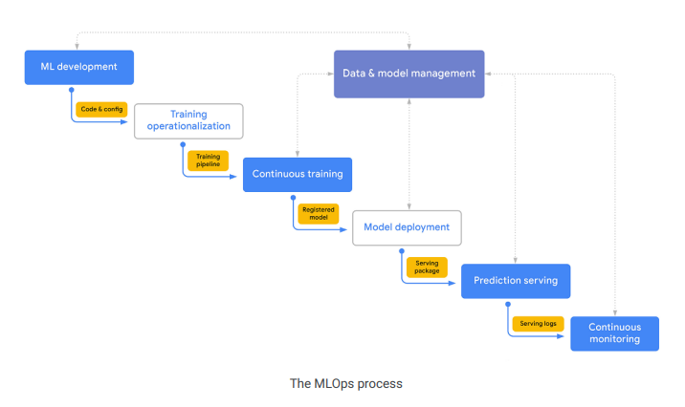
MLOps: An end-to-end workflow
A simplified but canonical flow for how the MLOps processes interact with each other

Slide 12
MLOps: An end-to-end workflow(2)
not a waterfall workflow that has to sequentially pass through all the processes
1. The core activity during ML development phase is experimentation
As data scientists and ML researchers prototype model architectures and training routines,
they create labeled datasets, and they use features and other reusable ML artifacts
The primary output is a formalized training procedure,
which includes data preprocessing, model architecture, and model training settings
2. If the ML system requires continuous training (repeated retraining of the model),
the training procedure is operationalized as a training pipeline
requires a CI/CD routine to build, test, and deploy the pipeline to the target execution environment
3. The continuous training pipeline is executed repeatedly based on retraining triggers produces a model as output
The model is retrained as new data becomes available, or if model performance decay is detected
Other training artifacts and metadata that are produced by a training pipeline are also tracked
If the pipeline produces a successful model candidate, that candidate is then tracked by the model management
process as a registered model

Slide 13
MLOps: An end-to-end workflow(3)
processes can be skipped, or the flow can repeat a given phase or a subsequence of the processes
4. The registered model is annotated, reviewed, and approved for release and is then deployed to a production environment
might be relatively opaque if using a no-code solution,
can involve building a custom CI/CD pipeline for progressive delivery
5. The deployed model serves predictions using the deployment pattern that is specified:
online, batch, or streaming predictions
the serving runtime can generate model explanations and capture serving logs to be used by the continuous monitoring process
6. The continuous monitoring process monitors the model for predictive effectiveness and service
The primary concern is detecting model decay—for example, data and concept drift
can also be monitored for efficiency metrics like latency, throughput, hardware resource utilization, and execution errors

Slide 14
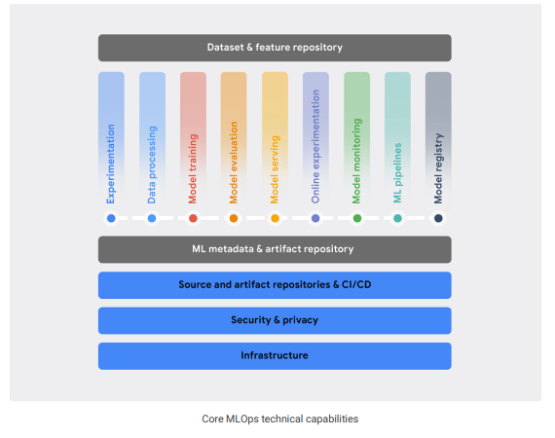
MLOps capabilities
core set of technical capabilities that are generally required for MLOps
To effectively implement the key MLOps processes,
organizations need to establish a set of core technical capabilities
which can be provided by a single integrated ML platform
Alternatively, they can be created by combining vendor tools that each are best suited to particular tasks
In most cases, the processes are deployed in stages rather than all at once in a single deployment
For example, many organizations start by focusing on the processes for ML development, model deployment, and prediction serving
For these organizations, continuous training and continuous monitoring might not be necessary
if they are piloting a relatively small number of ML systems

Slide 15
MLOps capabilities(2)
Foundational and ML Specific
Foundational capabilities
are required in order to support any IT workload, such as a reliable, scalable, and secure compute infrastructure
already have investments in these capabilities and can benefit by taking advantage of them for ML workflows
might span multiple clouds, or even operate partially on-premises
Ideally, this would include advanced capabilities such as specialized ML accelerators
Standardized configuration management and CI/CD capabilities
required to build, test, release, and operate software systems rapidly and reliably, including ML systems
MLOps capabilities
include experimentation, data processing, model training, model evaluation, model serving, online experimentation,
model monitoring, ML pipeline, and model registry
Cross-cutting capabilities
enable integration and interaction are an ML metadata and artifact repository and an ML dataset and feature repository

Slide 16
MLOps capability - Experimentation
Lets data scientists and ML researchers collaboratively
perform exploratory data analysis,
create prototype model architectures
and implement training routines
An ML environment should also let them write modular, reusable, and testable source code
that is version controlled
Key functionalities in experimentation:
Provide notebook environments that are integrated with version control tools like Git
Track experiments, including information about the data, hyperparameters, and evaluation metrics for reproducibility and comparison
Analyze and visualize data and models
Support exploring datasets, finding experiments, and reviewing implementations
Integrate with other data services and ML services in platform

Slide 17
MLOps capability - Data processing
Allows to prepare and transform large amounts of data for ML at scale in ML development,
in continuous training pipelines, and in prediction serving
Key functionalities:
Support interactive execution (for example, from notebooks) for quick experimentation and for long-running jobs in production
Provide data connectors to a wide range of data sources and services, as well as data encoders and decoders for various data structures and formats
Provide both rich and efficient data transformations and ML feature engineering for structured (tabular) and unstructured data (text, image, and so on)
Support scalable batch and stream data processing for ML training and serving workloads

Slide 18
MLOps capability - Model training
Lets you efficiently and cost-effectively run powerful algorithms for training ML models
Model training should be able to scale with size of both models and datasets that are used for training
Key functionalities:
Support common ML frameworks and support custom runtime environments
Support large-scale distributed training with different strategies for multiple GPUs and multiple workers
Enable on-demand use of ML accelerators
Allow efficient hyperparameter tuning and target optimization at scale
Ideally, provide built-in automated ML (AutoML) functionality,
including automated feature selection and engineering as well as automated model architecture search and selection

Slide 19
MLOps capability - Model evaluation
Lets you assess the effectiveness of model,
interactively during experimentation and automatically in production
Key functionalities:
Perform batch scoring of models on evaluation datasets at scale
Compute pre-defined or custom evaluation metrics for model on different slices of the data
Track trained-model predictive performance across different continuous-training executions
Visualize and compare performances of different models
Provide tools for what-if analysis and for identifying bias and fairness issues
Enable model behavior interpretation using various explainable AI techniques

Slide 20
MLOps capability - Model serving
Lets you deploy and serve models in production environments
Key functionalities:
Provide support for low-latency, near-real-time (online) prediction and high-throughput batch (offline) prediction
Provide built-in support for common ML serving frameworks and for custom runtime environments
Enable composite prediction routines, where multiple models are invoked hierarchically or simultaneously
Allow efficient use of ML inference accelerators with autoscaling to match spiky workloads and to balance cost with latency
Support logging of prediction serving requests and responses for analysis

Slide 21
MLOps capability - Online experimentation
Lets you understand how newly trained models perform in production settings compared to the current models
before you release the new model to production
For example, using a small subset of the serving population,
use online experimentation to understand the impact that a new recommendation system has on click-throughs and on conversation rates
results of online experimentation should be integrated with the model registry capability to facilitate the decision about releasing the model to production
Online experimentation enhances the reliability of ML releases by helping in deciding to discard ill-performing
models and to promote well-performing ones
Key functionalities:
Support canary and shadow deployments
Support traffic splitting and A/B tests
Support multi-armed bandit (MAB) tests

Slide 22
MLOps capability - Model monitoring
Lets you track the efficiency and effectiveness of the deployed models in production
to ensure predictive quality and business continuity
Informs if models are stale and need to be investigated and updated
Key functionalities:
Measure model efficiency metrics like latency and serving-resource utilization
Detect data skews, including schema anomalies and data and concept shifts and drifts
Integrate monitoring with the model evaluation capability for continuously assessing
the effectiveness performance of the deployed model when ground truth labels are available

Slide 23
MLOps capability - ML pipelines
Lets you instrument, orchestrate, and automate complex ML training and prediction pipe-lines in production
ML workflows coordinate different components, where each component performs a specific task in the pipeline
Key functionalities:
Trigger pipelines on demand, on a schedule, or in response to specified events
Enable local interactive execution for debugging during ML development
Integrate with the ML metadata tracking capability to capture pipeline execution parameters and to produce artifacts
Provide a set of built-in components for common ML tasks and also allow custom components
Run on different environments, including local machines and scalable cloud platforms
Optionally, provide GUI-based tools for designing and building pipelines

Slide 24
MLOps capability - Model registry
Lets you govern the lifecycle of the ML models in a central repository
ensures the quality of the production models and enables model discovery
Key functionalities:
Register, organize, track, and version trained and deployed ML models
Store model metadata and runtime dependencies for deployability
Maintain model documentation and reporting—for example, using model cards
Integrate with the model evaluation and deployment capability and track online and offline evaluation metrics for the models
Govern the model launching process: review, approve, release, and roll back

Slide 25
MLOps capability - Dataset and feature repository
Lets you unify the definition and the storage of the ML data assets
Having a central repository of fresh, high-quality data assets enables shareability, discoverability, and reusability
provides data consistency for training and inference
saves time on data preparation and feature engineering, which typically take up a significant amount of their time
Key functionalities:
Enable shareability, discoverability, reusability, and versioning of data assets
Allow real-time ingestion and low-latency serving for event streaming and online prediction workloads
Allow high-throughput batch ingestion and serving for extract, transform, load (ETL) processes and model training, and for scoring workloads
Enable feature versioning for point-in-time queries
Support various data modalities, including tabular data, images, and text
ML data assets can be managed at the entity features level or at the full dataset level
Feature repository might contain an entity called customer, which includes features
like age group, postal code, and gender
Dataset repository might include a customer churn dataset,
which includes features from the customer and product entities, as well as purchase- and web-activity event logs

Slide 26
MLOps capability - ML metadata and artifact tracking
Various types of ML artifacts are produced in different processes of the MLOps lifecycle,
including descriptive statistics and data schemas, trained models, and evaluation results
ML metadata is the information about these artifacts,
including their location, types, properties, and associations to experiments and runs
The ML metadata and artifact tracking capability is foundational to all other MLOps capabilities
enables reproducibility and debugging of complex ML tasks and pipelines
Key functionalities:
Provide traceability and lineage tracking of ML artifacts
Share and track experimentation and pipeline parameter configurations
Store, access, investigate, visualize, download, and archive ML artifacts
Integrate with all other MLOps capabilities

Slide 27
Thank You!
In our next session:

